Slide 1


PT. MITRAKARYA NIAGA ANTAR BANGSA
Bringing Indonesia’s Natural Richness to the World
https://mitrakaryaniaga.co.id/

Slide 2
ABOUT THE COMPANY
PT. Mitrakarya Niaga Antarbangsa is an Indonesian export company specializing in agricultural and natural commodities. We are committed to providing high-quality, premium Indonesian products for the global market. Our core focus includes coconut derivatives, spices, coffee, plantation yields, and a variety of other agricultural commodities sourced directly from various regions across Indonesia.
Prioritizing quality, on-time delivery, and professional service, PT. Mitrakarya Niaga Antarbangsa stands as a trusted partner for international buyers.
Supported by a wide network of partnerships with farmers, local producers, and farmer groups throughout the archipelago, the company continues to expand its export reach to Asia, the Middle East, Europe, and Latin America. With standardized quality management systems and export documentation, we are committed to bringing Indonesian products to the global stage while contributing to the economic development of local communities.

Slide 3





Our Finest Service
SOURCING RAW
MATERIAL
PRODUCT
DEVELOPMENT
In Industry 4.0, finding quality raw materials is challenging. Our trusted company, backed by experts, helps you choose the right ones—because great products start with the best materials.
We develop products through research, expert collaboration, and customer involvement. With flexible order quantities, we help define your product’s strengths for confident market entry.
Service
CUSTOM PACKAGING & DESIGN
QUALITY CONTROL
Packaging defines how your product competes. We help you choose trendy, eye-catching primary and secondary packaging that adds value and attracts your target customers.
We ensure your product’s quality and packaging are professionally monitored, maintaining consistency to guarantee lasting stability and reliability.
Copyright © PT. Mitrakarya Niaga Antarbangsa. All Rights Reserved.

Slide 4
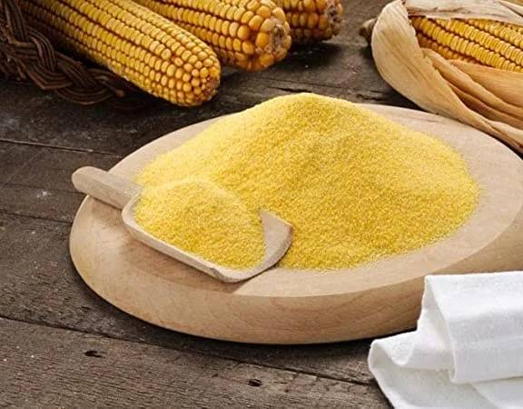
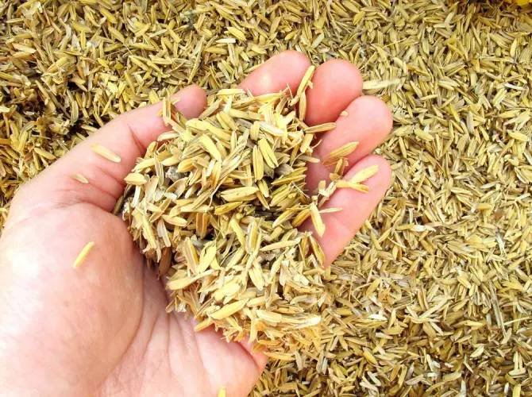
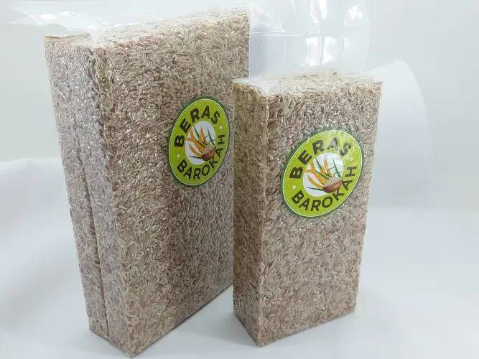
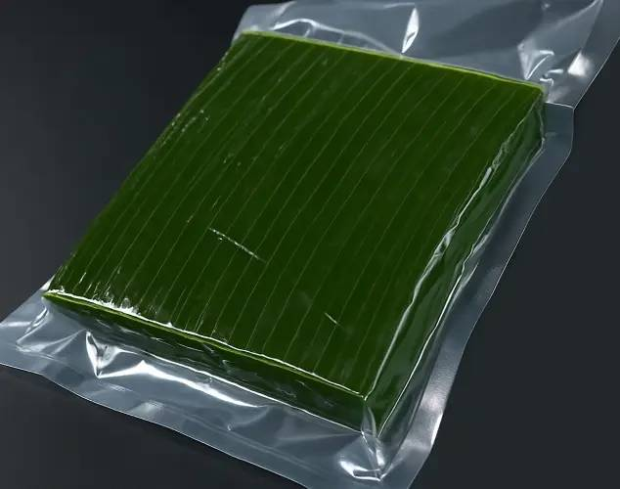
Agricultural Commodities
Corncob Powder
Rice Husk
Red Rice
Banana Leaves
Corncob Powder is an eco-friendly, sustainable product made from ground corn cobs, ideal for improving soil and agriculture.
Rice Husk is an eco-friendly, versatile material used in agriculture and energy, improving soil and supporting sustainability.
Red Rice is a nutritious, high-fiber rice that supports digestion and blood sugar control, offering a healthy and delicious alternative.
Banana Leaves are eco-friendly, versatile, and aromatic natural materials used for food wrapping, ceremonies, and crafts worldwide.
Copyright © PT. Mitrakarya Niaga Antarbangsa. All Rights Reserved.

Slide 5
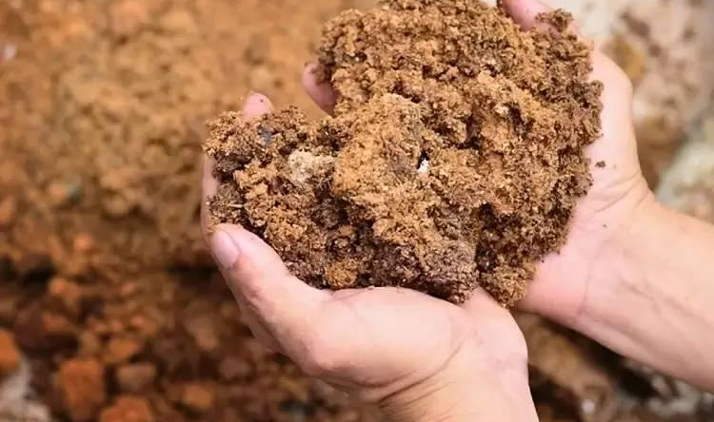
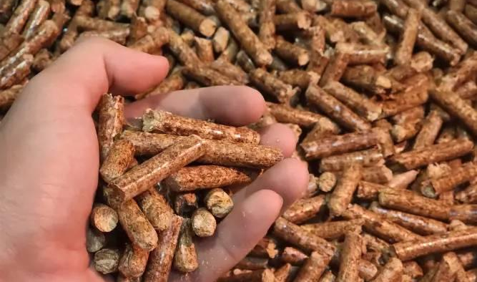
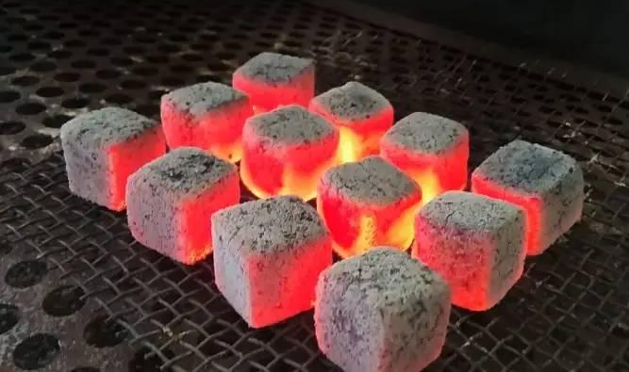
Bioenergy
Palm Kernel Expeller
Wood pellets
Coconut charcoal briquettes
Palm Kernel Expeller (PKE) is a high-protein, energy-rich, low-fat livestock feed that supports healthy growth, productivity, and sustainable farming.
Wood pellets are eco-friendly, high-density biofuels from wood waste, providing efficient, low-emission energy for heating and biomass power.
Coconut charcoal briquettes are eco-friendly, long-burning, low-smoke fuel from coconut shells, ideal for cooking, BBQ, and safe for health.
Copyright © PT. Mitrakarya Niaga Antarbangsa. All Rights Reserved.

Slide 6
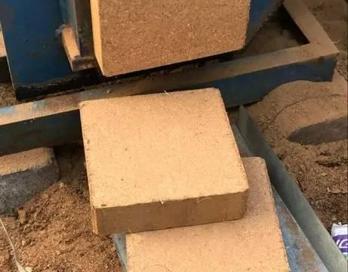
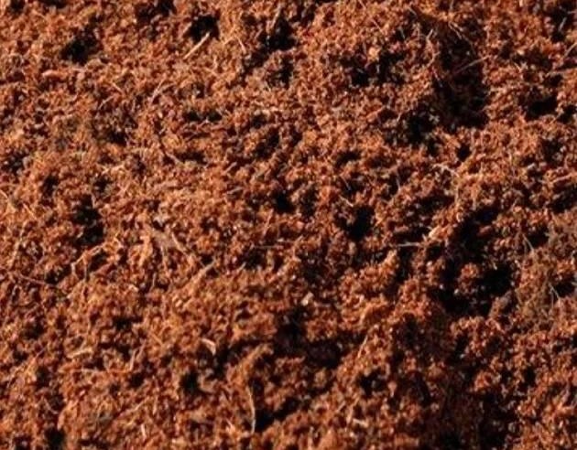
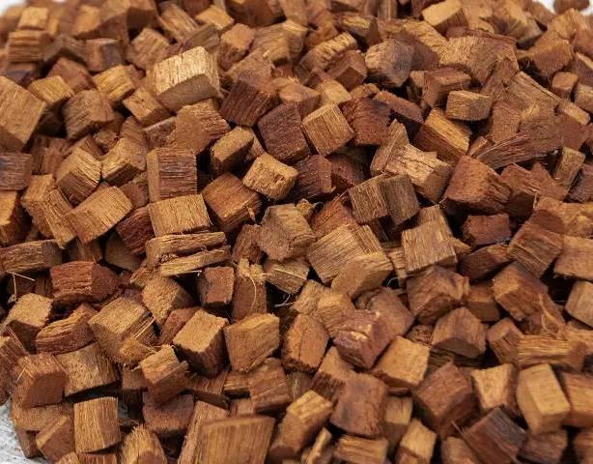
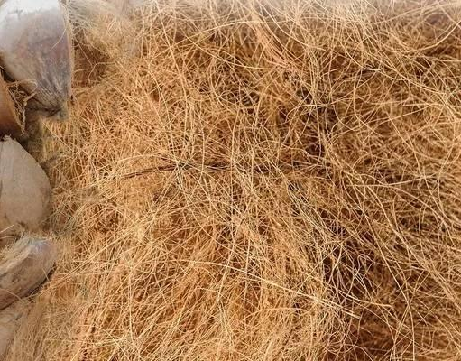
Coconut Derivative Products
Cocopeat blocks
Cocopeat Loose
Coco Chips
Coconut Husk Fiber
Cocopeat blocks are eco-friendly, water-retentive growing medium from coconut coir, ideal for hydroponics, farming, and seedlings.
Cocopeat Loose is a lightweight, eco-friendly coconut coir medium, retaining water and aeration for healthy plant growth
Coco Chips are eco-friendly, lightweight coconut husk chunks, retaining water and aeration for healthy plant growth.
Coconut Husk Fiber (coir) is eco-friendly, strong, and versatile, used in ropes, mats, and as a water-retentive growing medium.
Copyright © PT. Mitrakarya Niaga Antarbangsa. All Rights Reserved.

Slide 7
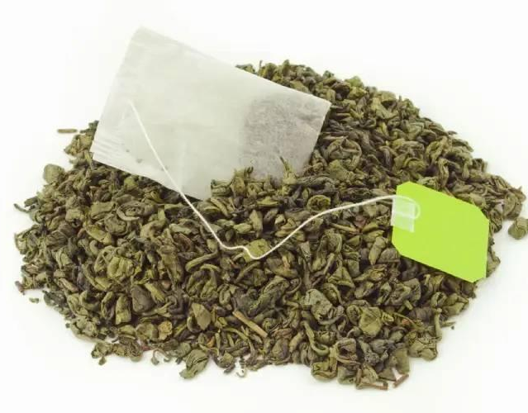
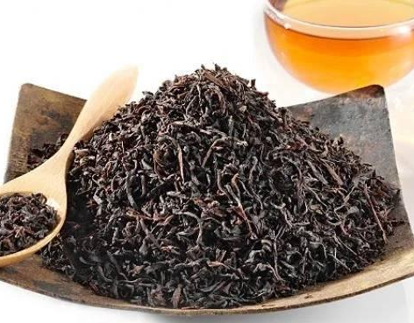
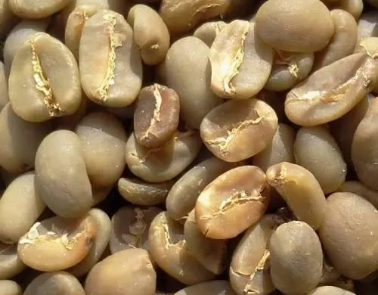
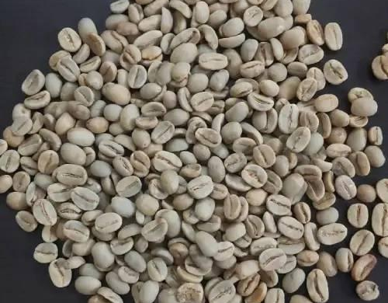
Coffee and Tea
Green Tea
Black Tea
Coffee Beans
Arabica Coffee Beans
Green Tea is a nutrient-rich, antioxidant beverage with fresh aroma and light flavor, supporting health, metabolism, and wellbeing.
Black Tea is a rich, antioxidant-packed beverage with bold flavor and aroma, supporting immunity, metabolism, and heart health.
Coffee Beans are premium Arabica, Robusta, and Liberica seeds, delivering rich flavor, aroma, and energy for coffee lovers.
Arabica Coffee Beans are premium, smooth, and aromatic, with balanced acidity and sweet, fruity, floral flavor notes.
Copyright © PT. Mitrakarya Niaga Antarbangsa. All Rights Reserved.

Slide 8
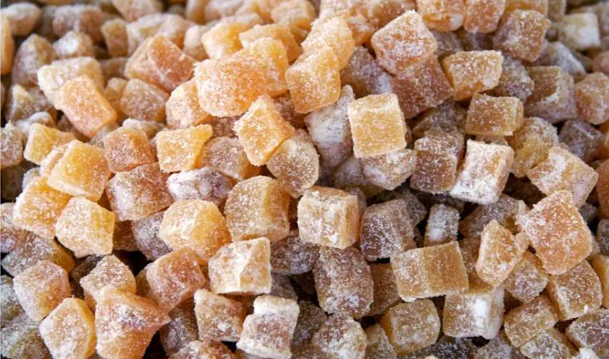
Ginger Candy
Original Ginger Candy
Original Ginger Candy is a natural, spicy-sweet treat made from real ginger, helping ease colds, soothe sore throats, relieve nausea, and boost immunity.
Copyright © PT. Mitrakarya Niaga Antarbangsa. All Rights Reserved.

Slide 9
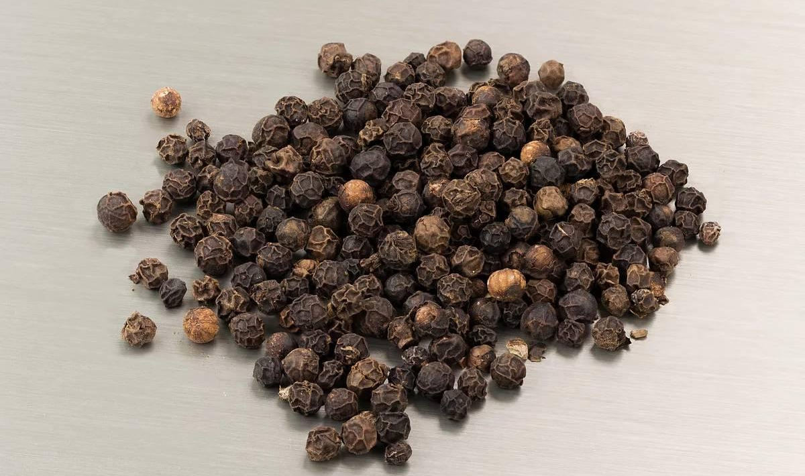
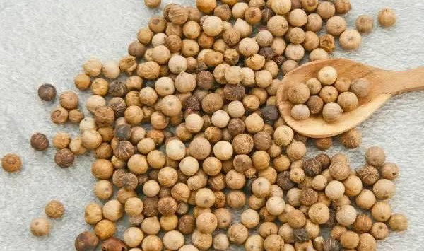
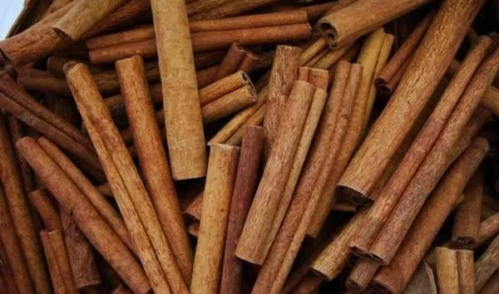
Others: Indonesian Spices
Black Pepper
White Pepper
Cinnamon
Black Pepper is a bold, aromatic spice rich in piperine, boosting metabolism, aiding digestion, supporting respiratory health, and as an antioxidant.
White Pepper is a mild, aromatic spice that aids digestion, boosts metabolism, relieves colds, and adds gentle heat to soups, sauces, and seafood.
Cinnamon is a sweet, aromatic spice that aids metabolism, supports heart health, provides antioxidants, and adds warm flavor to foods and drinks.
Copyright © PT. Mitrakarya Niaga Antarbangsa. All Rights Reserved.

Slide 10
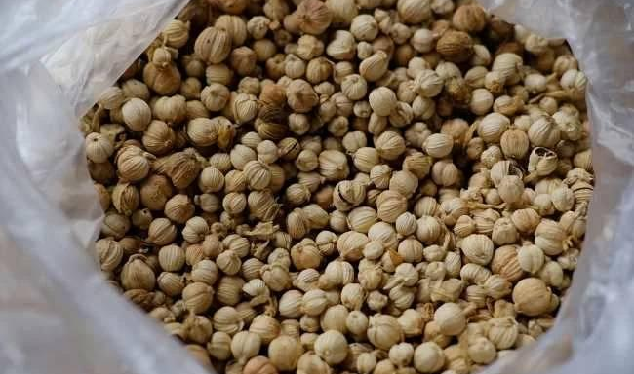
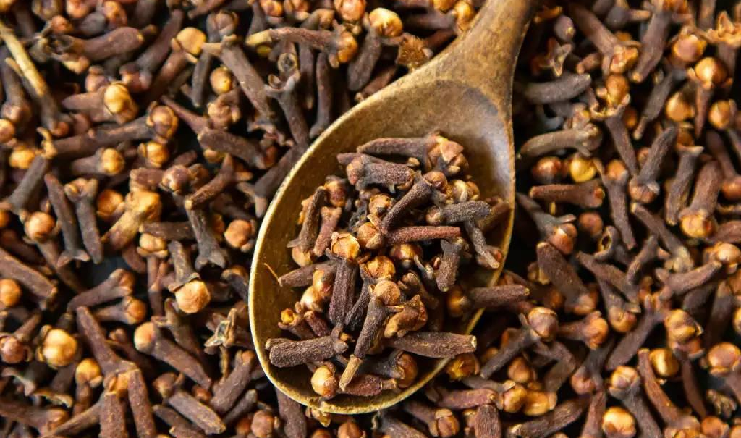
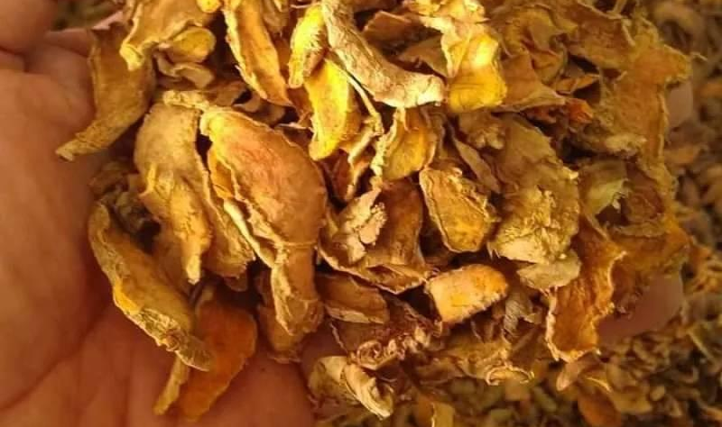
Others: Indonesian Spices
Cardamom
Cloves
Dried Turmeric
Cardamom is a fragrant, sweet-spicy spice that aids digestion, freshens breath, supports immunity, and enhances teas, coffees, and pastries.
Cloves are aromatic, warm spices rich in eugenol, aiding digestion, reducing inflammation, boosting immunity, and flavoring foods, drinks, and kretek.
Dried Turmeric is a golden, aromatic spice rich in curcumin, aiding digestion, reducing inflammation, boosting immunity, and enhancing foods and drinks.
Copyright © PT. Mitrakarya Niaga Antarbangsa. All Rights Reserved.

Slide 11
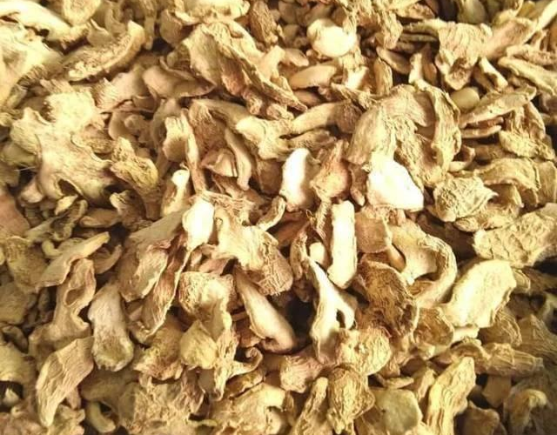
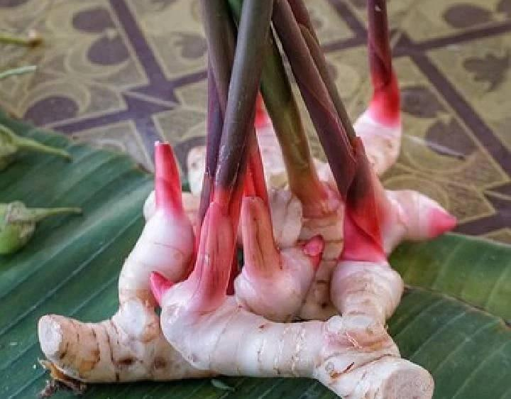
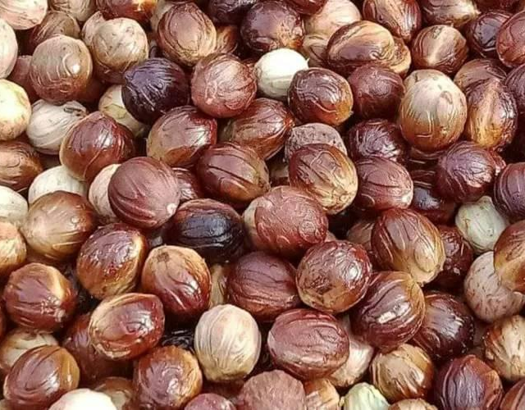
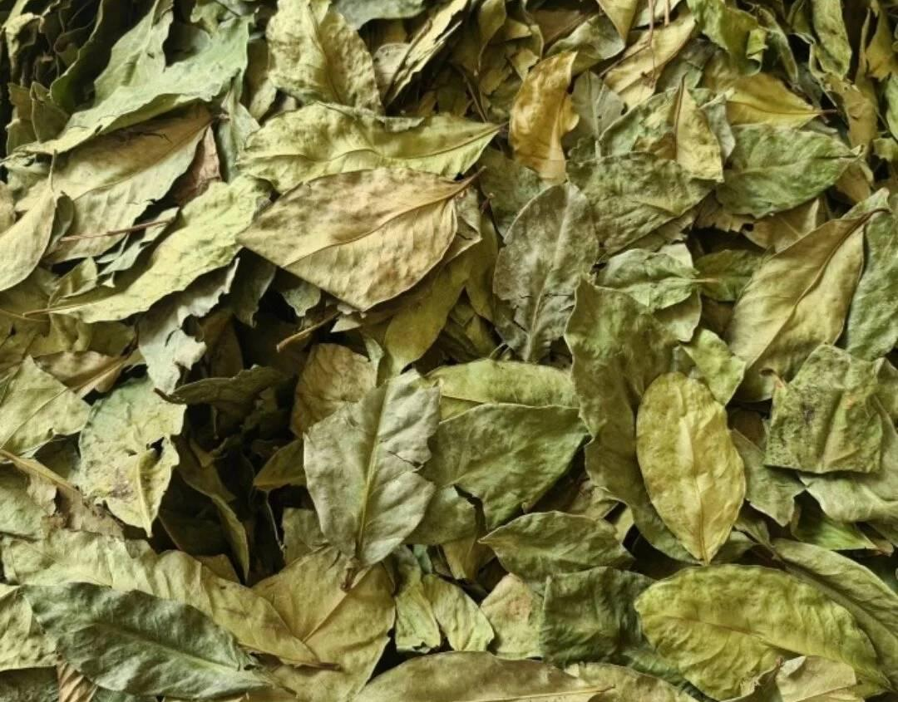
Others: Indonesian Spices
Dried Ginger
Galangal
Nutmeg
Dried Bay Leaves
Dried Ginger is a warm, aromatic spice that relieves colds, nausea, boosts immunity, and is widely used in food and herbal drinks.
Galangal (Lengkuas) is a spicy-aromatic spice that aids digestion, reduces inflammation, boosts immunity, and flavors Asian dishes.
Nutmeg is a warm, sweet-spicy spice that aids digestion, improves sleep, relieves pain, and flavors foods, drinks, and desserts.
Dried Bay Leaves are aromatic spices that aid digestion, support immunity, reduce cholesterol, and enhance soups, stews, curries.
Copyright © PT. Mitrakarya Niaga Antarbangsa. All Rights Reserved.

Slide 12
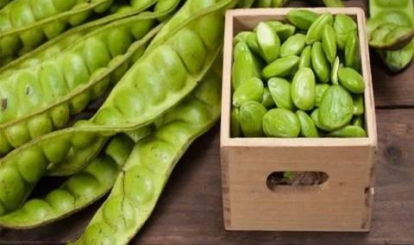
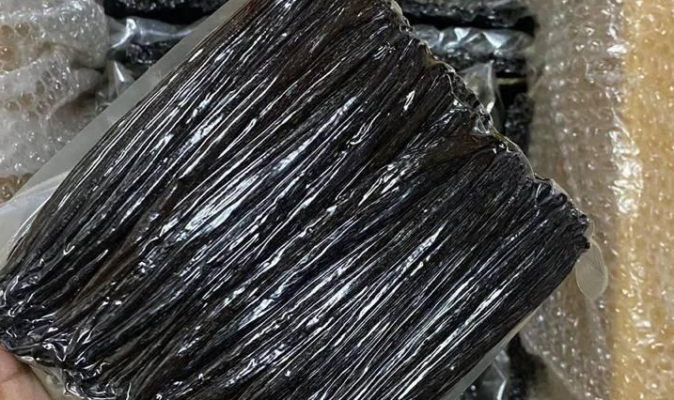
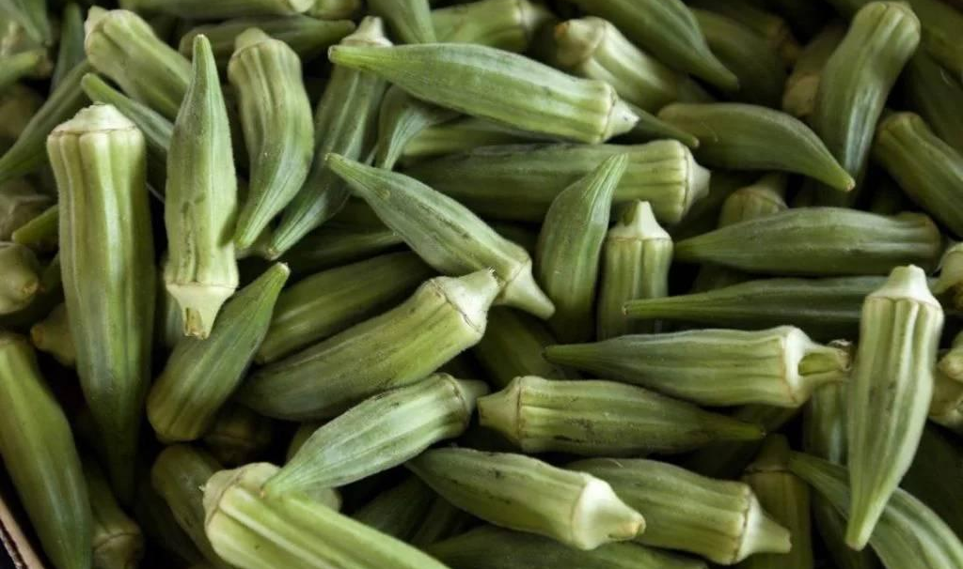
Fruits
Fresh Stinky Beans
Vanilla Beans
Okra
Fresh Stinky Beans (Pete) from Indonesia are protein-rich, flavorful, aromatic, and ideal for stir-fries, sambals, curries, and gourmet dishes.
Premium Vanilla Beans from Indonesia, sun-cured for rich aroma and flavor, ideal for gourmet foods, beverages, cosmetics, and fragrance industries.
Fresh Okra (Lady’s Finger) are nutrient-rich, tender green pods, ideal for stews, curries, stir-fries, supporting digestion and immune health.
Copyright © PT. Mitrakarya Niaga Antarbangsa. All Rights Reserved.

Slide 13
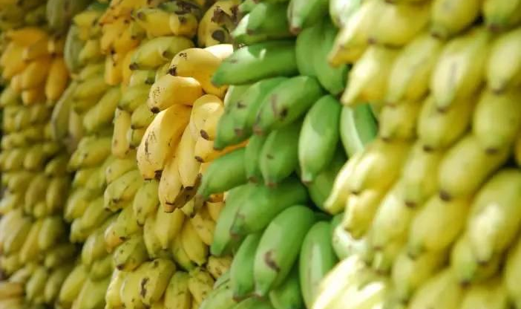
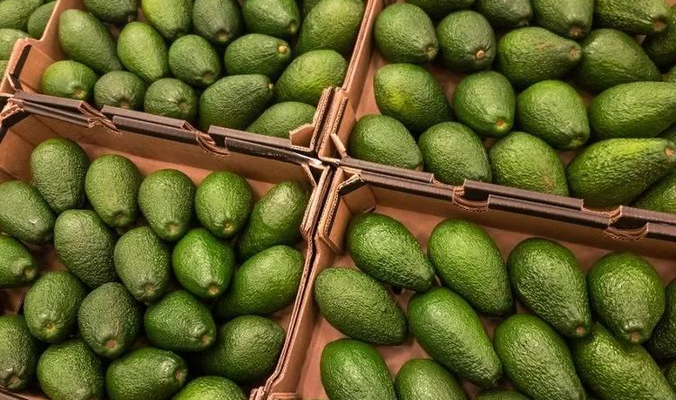
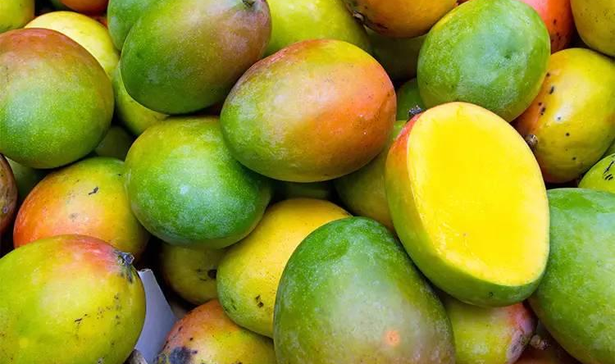
Fruits
Bananas
Avocados
Mangoes
Indonesian Bananas are naturally sweet, soft, and nutritious, perfect for fresh consumption or as raw material for the food industry worldwide.
Indonesian Avocados are creamy, flavorful, and nutrient-rich, harvested at peak ripeness, ideal for fresh consumption and culinary uses worldwide.
Indonesian Tropical Mangoes are sweet, fragrant, and juicy with thick flesh, carefully harvested and packaged to meet premium international standards.
Copyright © PT. Mitrakarya Niaga Antarbangsa. All Rights Reserved.

Slide 14
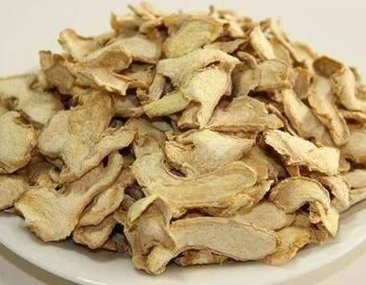
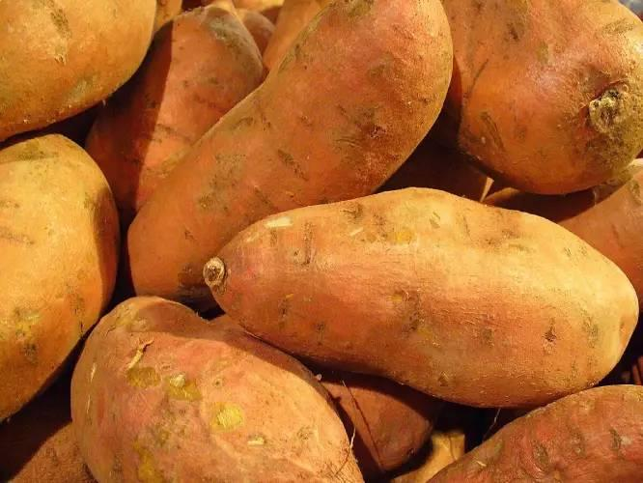
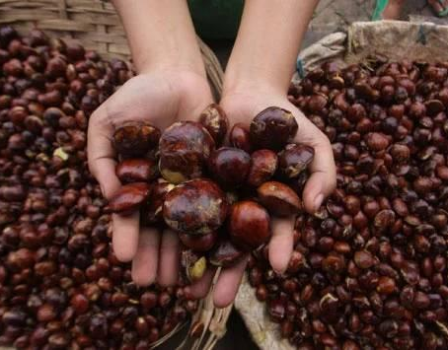
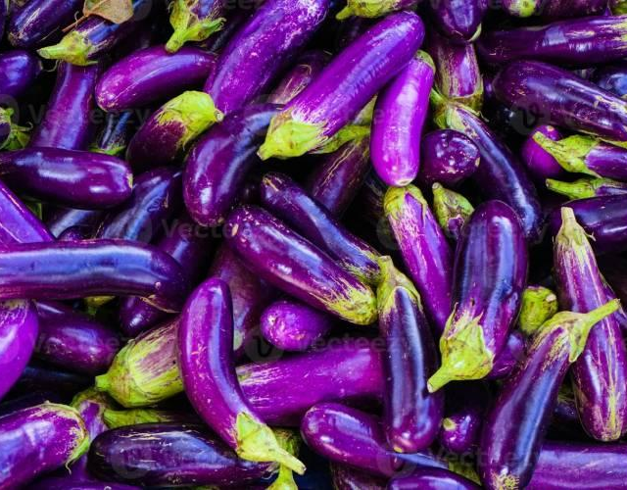
Vegetables
Dry Ginger
Sweet Potatoe
Dogfruit
Eggplants
Dry Ginger is a potent, aromatic spice rich in gingerol, offering anti-inflammatory benefits, long shelf life, and versatile culinary use.
Sweet Potatoes are naturally sweet, nutrient-rich roots, rich in fiber, vitamins, antioxidants, and ideal for versatile cooking.
Dogfruit (Jengkol) is a unique Indonesian vegetable with soft texture, strong aroma, and valued in local and international markets.
Eggplants are fresh, firm, and glossy purple, rich in nutrients, versatile for cooking, and carefully packed for export quality.
Copyright © PT. Mitrakarya Niaga Antarbangsa. All Rights Reserved.

Slide 15
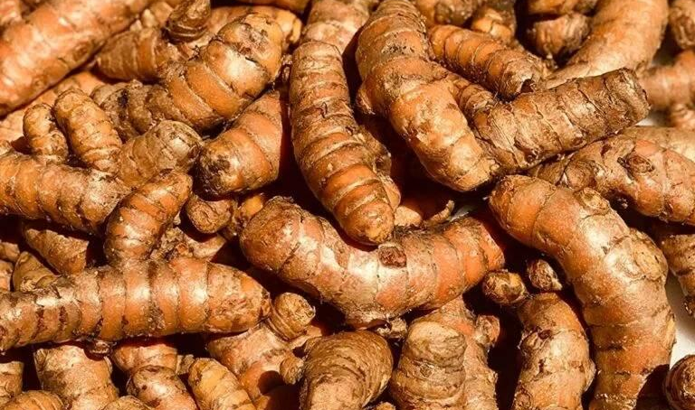
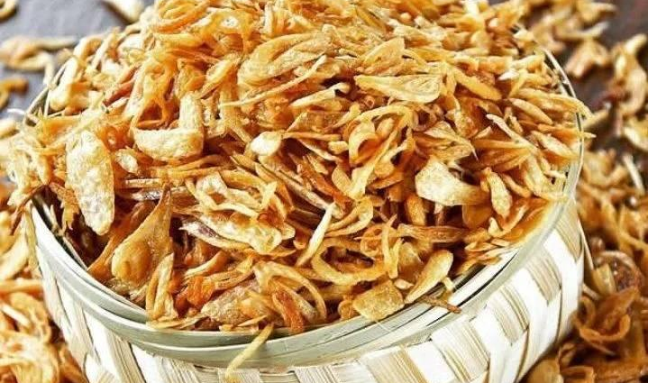
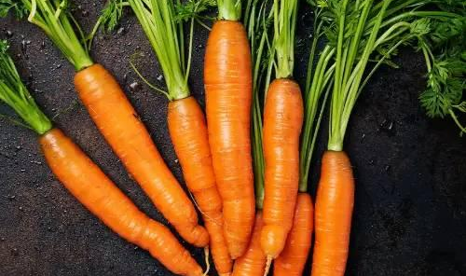
Vegetables
Turmeric
Sweet Potatoe
Carrots
Indonesian Turmeric is vibrant, aromatic, and healthful, exported fresh or dried for use in spices, herbal remedies, and the health industry.
Premium Fried Shallots are crispy, aromatic, preservative-free, and perfect for enhancing fried rice, soups, noodles, and international dishes.
Indonesian Carrots are sweet, crunchy, and nutrient-rich, high in beta-carotene and antioxidants, sustainably grown and export-ready.
Copyright © PT. Mitrakarya Niaga Antarbangsa. All Rights Reserved.

Slide 16
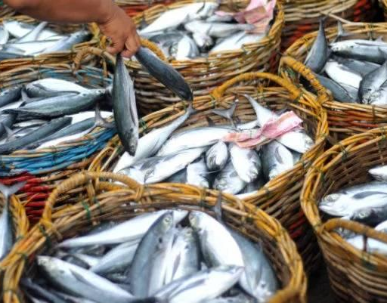
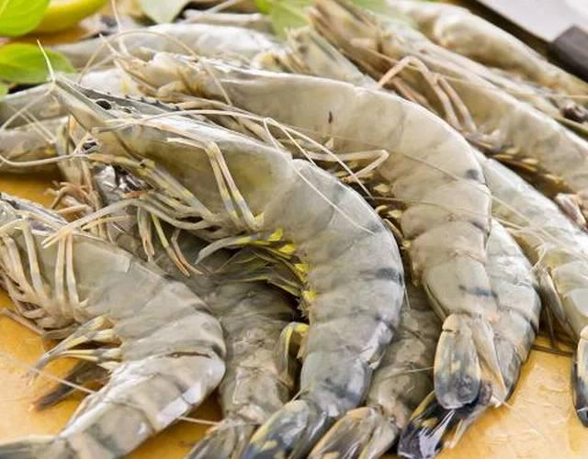
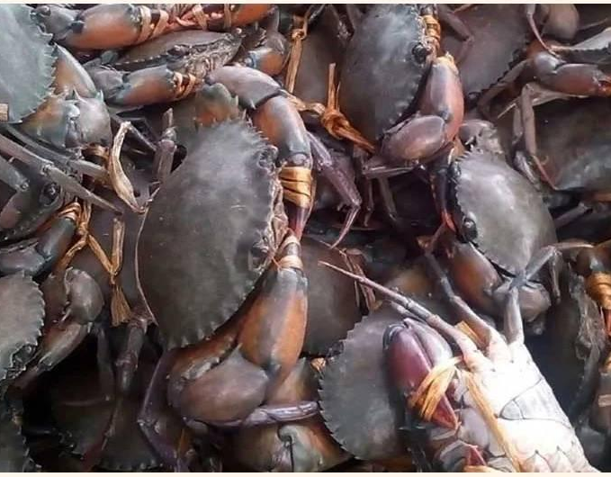
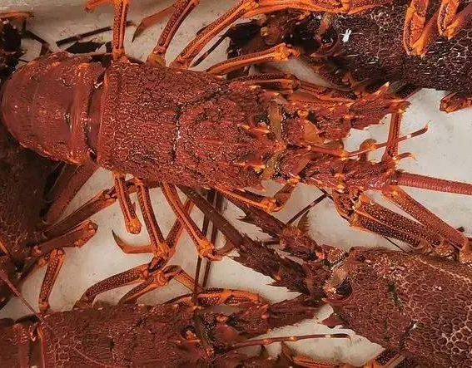
Seafood
Fish
Shrimp
Crabs
Lobsters
Fresh Indonesian fish, sustainably sourced, nutritious, hygienically packed, and export-ready to meet international quality standards.
Fresh Indonesian shrimp, high in protein and flavor, sustainably sourced from aquaculture and natural waters, export-ready.
Indonesian crabs are sweet, tender, nutritious, sustainably sourced, hygienically processed, and exported fresh worldwide.
Indonesian Lobsters are tender, flavorful, premium-quality, sustainably sourced, and exported fresh or frozen to international markets.
Copyright © PT. Mitrakarya Niaga Antarbangsa. All Rights Reserved.

Slide 17
FAQ — Private Label / OEM
Private Label /
OEM
OEM Benefits
Global Trust
Companies choose OEM like us for cost savings, speed, and quality without heavy investment.
Trusted worldwide for quality, expertise, on-time delivery, and innovative manufacturing solutions.
Do you provide Private Label service?
Which products are available for Private Label?
Yes, we offer Private Label and OEM services for all export products.
Red rice, ketapang leaves, banana leaves, coffee beans, wood pellets, and coconut charcoal briquettes.
FAQ
What is the minimum order for Private Label?
Can we use our own brand and packaging design?
MOQ depends on product type, usually starting from 1,000 kg per shipment.
Yes, you can use your own logo, packaging design, and label for your market.
Do you assist with packaging design?
Production & Delivery
Yes, we can provide packaging design assistance upon request or use your existing design files.
Private Label - OEM
Production takes 10–20 working days, depending on product and order volume. Shipping duration depends on destination country.
Your trusted partner for seamless Private Label & OEM manufacturing solutions.
Copyright © PT. Mitrakarya Niaga Antarbangsa. All Rights Reserved.

Slide 18












Copyright © PT. Mitrakarya Niaga Antarbangsa. All Rights Reserved.

Slide 19
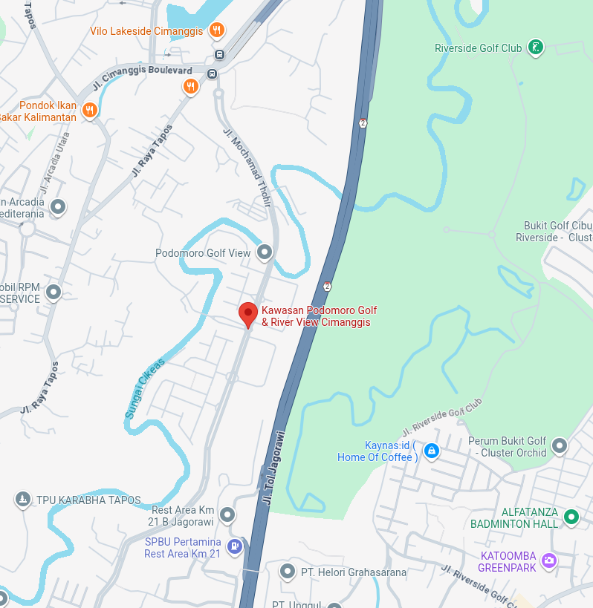
Address
Podomoro Golf View Tower Balsa, Jalan Mochamad Thohir Exit Tol Cimanggis (KM19)-Tol Jagorawi Gunung Putri, Bogor, 16963 Indonesia
Telphone
+62 822 1000 6695
Email
sales@mitraexports.id
sales@agronusantara.id
Website
www.MitraKaryaNiaga.co.id
www.agronusantara.id
www.mitraexports.id

Slide 20
THANK YOU
PT. Mitrakarya Niaga Antarbangsa, Indonesia
e-mail: sales@mitraexports.id

